Slide 1
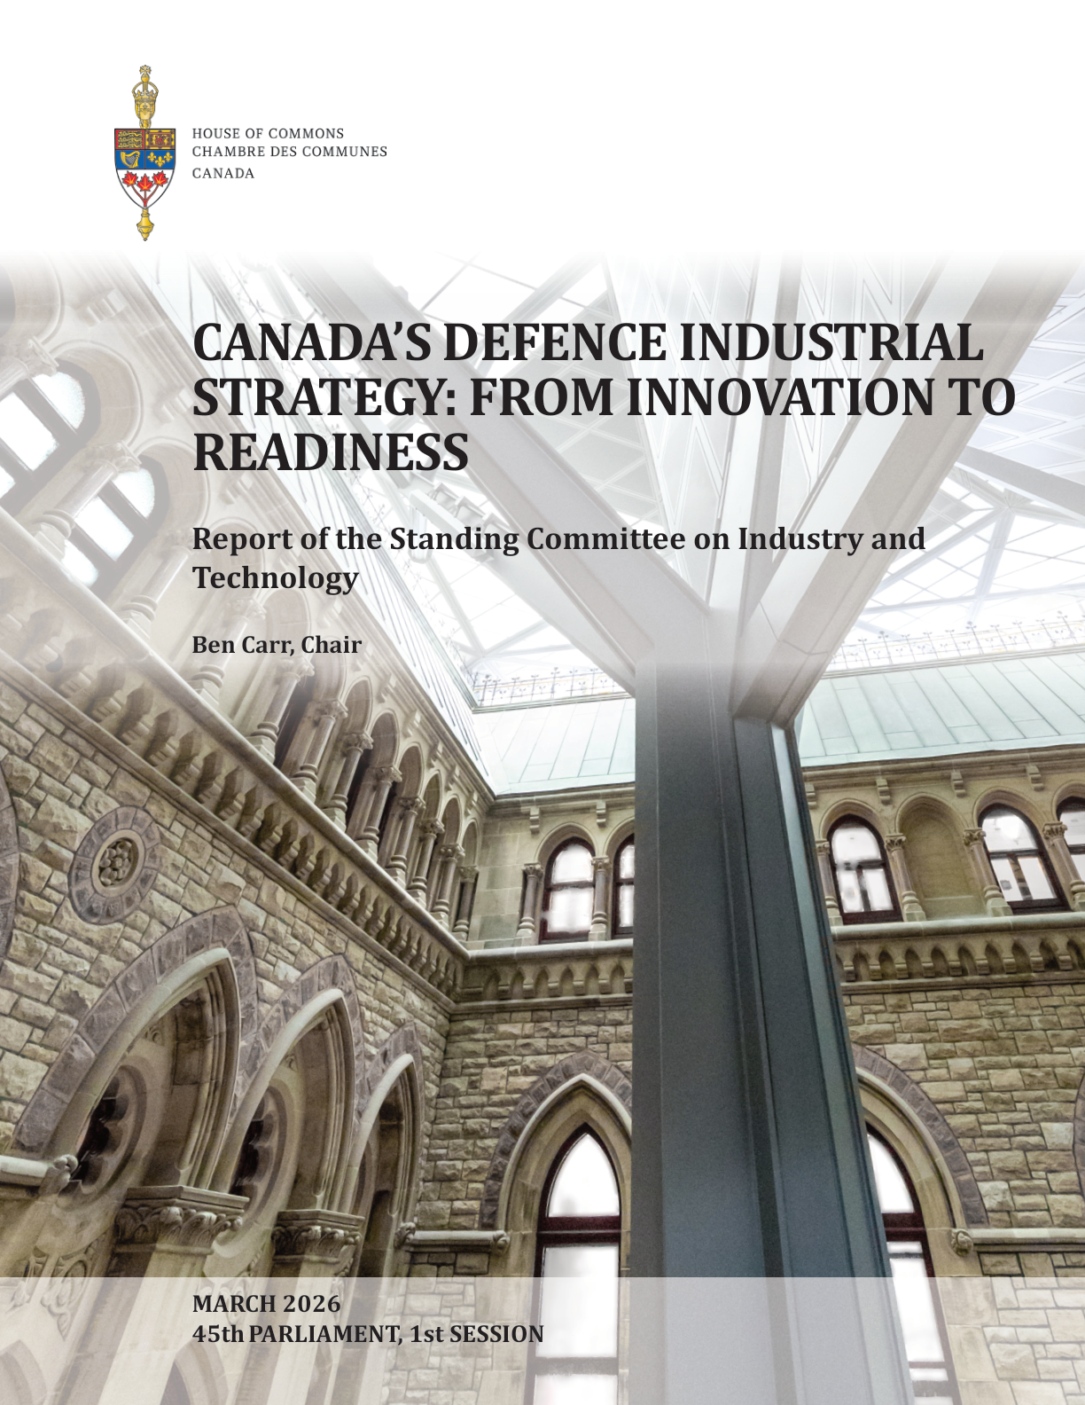
A reading of a parliamentary report
From Innovation to Readiness
Canada's Defence Industrial Strategy and what it means for public policy
Second Report of the House of Commons Standing Committee on Industry and Technology • March 2026
[Presenter name and affiliation]
[Date / venue]
Source: House of Commons Standing Committee on Industry and Technology, Second Report, March 2026
01
Notes:
Keep the cover clean and explicitly attribute the source to the committee, not to the chair alone. Frame the presentation as a public-policy and economic-policy reading of the report. The committee was chaired by Ben Carr, with Raquel Dancho and Gabriel Ste-Marie as vice-chairs.

Slide 2
Why now — a strategic and fiscal turning point
Three forces are converging on Canada at once
Geopolitics
NATO commitments
Domestic fiscal moment
Global instability, supply-chain threats and fast military-technological change are creating pressure to act faster.
Canada plans to reach 5% of GDP on defence by 2035: 3.5% core defence + 1.5% ancillary / dual-use investments.
Budget 2025 announced major defence investments; the government released its DIS just as the committee finalized the report.
“Sustained increases in defence expenditures will require explicit fiscal trade-offs.”
PBO testimony summarized in the committee report
For an economic-policy audience, the “ancillary” 1.5% is where defence overlaps with infrastructure, critical minerals, and industrial policy.
Source: House of Commons Standing Committee on Industry and Technology, Second Report, March 2026
02
Notes:
Set the stakes. Emphasize that this is not simply a defence file: the fiscal question, the NATO target, and the dual-use spending category all make this an economic-policy story. The PBO is preparing a separate report on the impact of reaching 3.5% core and 1.5% ancillary spending by 2035.

Slide 3
The report at a glance
What the committee did, and what it produced
6
35
12
20
+1
committee meetings
witnesses
written briefs
recommendations
supplementary opinion
Source document
Mandate signal
Second Report of the House of Commons Standing Committee on Industry and Technology, 45th Parliament, 1st Session (March 2026).
The study framed defence industrial strategy as both “self-reliance in national defence and security” and “procurement opportunities for Canadian businesses.”
The deck follows the supplied outline: source orientation → economic footprint → main challenges → principles → recommendations → open questions.
Source: House of Commons Standing Committee on Industry and Technology, Second Report, March 2026
03
Notes:
Orient the audience quickly. The process details are included to establish credibility, but the presentation should move quickly to findings. Mention the committee’s dual mandate: self-reliance and business opportunity.

Slide 4
Canada's defence industry today
A significant, export-oriented, regionally distributed sector
620+
$9.6B
81,200
Export orientation
firms
GDP contribution
jobs
63% of defence exports to the U.S.
11% to Europe
5% to the U.K.
Regional systems, not one sector
Industrial and Technological Benefits (ITB) policy
• Aerospace: QC, ON, MB, BC
• Shipbuilding / marine
• Quantum, AI, autonomous systems
• Critical minerals and advanced manufacturing
Estimated to contribute ~ $4.7B to Canada’s GDP.
Nuance: PBO noted ITB-eligible contracts do not always translate directly into production in Canada or Canadian-owned firms.
Quebec aerospace alone: ~250 firms, 43,000 workers, $23B in annual sales.
CADSI view: a coherent DIS could plausibly double the industrial base over a decade.
Source: House of Commons Standing Committee on Industry and Technology, Second Report, March 2026
04
Notes:
Use this slide to establish that the sector is economically significant and regionally distributed. The regional distribution matters politically: this is not a single regional interest. If challenged on ITB, note the PBO nuance that contracts subject to ITB obligations do not necessarily flow to Canadian-owned firms or direct production.

Slide 5
Canada's place in allied supply chains
A second-tier defence power, integrated rather than autonomous
Canadian firms
& capabilities
U.S. / NORAD
interoperability
Allied supply
chains
Strategic reality
Upstream opportunities
• Canada’s strength lies in integration, not end-to-end domestic platform production.
• The Defence Production Sharing Agreement and NORAD tie Canada structurally to U.S. systems.
• F-35: full fleet of 88 could support ~5,000 direct/indirect jobs over program life.
Critical minerals such as gallium, germanium, tungsten, titanium, bismuth, graphite and some rare earths can support allied resilience.
The recurring concern: Canadian firms and IP developed with public support can be acquired or absorbed by foreign interests once technologies mature.
“There is no viable path to become a defence industrial autarky.”
Richard Shimooka, summarized in report
Source: House of Commons Standing Committee on Industry and Technology, Second Report, March 2026
05
Notes:
Frame the integration/sovereignty tension clearly. Lagassé’s caution is useful here: reorienting defence-industrial policy away from U.S.-aligned systems carries risks for interoperability with allies, including the U.K. and Australia. The IP-leakage concern connects to broader Canadian innovation-policy debates.

Slide 6
Challenge 1 — Procurement
“The old approach to procurement does not work at the speed of modern threats” — Matthew Lombardi
Procurement cycles
Commercial software cycles
5–15 years
months
Timelines incompatible with modern industry
Structural causes
• 18 months to clear an SME for a defence contract
• 14–15 months between award and contract signature reported by GALAXIA
• “Valley of death” between pilots and procurement
• Risk elimination over risk mitigation
• Fragmented governance across departments
• Limited visibility into CAF needs
• Weak R&D-to-acquisition pathway
Policy direction
Delegate small, iterative purchases; attach contracting mechanisms to innovation programs; reform or replace ITB.
Source: House of Commons Standing Committee on Industry and Technology, Second Report, March 2026
06
Notes:
This is the central challenge. Many other problems eventually route back to procurement. Flag Lagassé’s point that IDEaS may develop capability without a contracting mechanism that lets government acquire it. Lombardi and Intson’s “attritable mass” framing illustrates why drones and software require a different model than ships or fighters.

Slide 7
Challenge 2 — Capital
Defence firms cannot grow without predictable revenue
Multi-year
procurement
Revenue
certainty
Debt + equity
capital
Scale-up
capacity
Export + allied
market access
The broken link
Potential levers
• One-year contracts plus extensions do not provide enough bankable revenue certainty.
• Some firms reported sectoral stigma: refused services or difficulty attracting Canadian VC.
• Hardware-intensive defence tech faces particular financing barriers.
• Multi-year contracts upfront.
• BDC / EDC financing backed by procurement contracts.
• Participation in the Defence, Security and Resilience Bank: proposed $10B subscription → ~$50B financing power.
“The single most impactful thing the Crown can do is seed the venture capital ecosystem.”
Michael Smith, ONE9
Source: House of Commons Standing Committee on Industry and Technology, Second Report, March 2026
07
Notes:
Connect defence financing to familiar Canadian scale-up and capital-formation debates. Be even-handed: the PBO emphasized fiscal constraints, so financing levers should be understood alongside the fiscal envelope.

Slide 8
Challenge 3 — Talent and workforce
Skilled people are the binding constraint
Universities
& polytechnics
Co-ops
micro-credentials
experiential learning
Defence firms
& clusters
CAF users
& operators
Main diagnosis
Inclusive-economy lens
• Persistent STEM shortages across the defence value chain.
• Weak domestic pathways into engineering and trades.
• Military personnel need ongoing multi-role skills as software and hardware evolve.
Women-led SMEs are disproportionately affected by procurement and ITB complexity. Recommendation 18 proposes dedicated procurement streams for women-owned and Indigenous-owned SMEs with training and supports.
Policy implication: workforce strategy has to be treated as industrial infrastructure, not as an HR add-on.
Source: House of Commons Standing Committee on Industry and Technology, Second Report, March 2026
08
Notes:
Lean into the inclusive-economy dimension. Greenley of MDA Space argued that diversity and inclusion can be embedded as measurable business practices, which is a useful response to the view that equity is extraneous to defence procurement.

Slide 9
Challenge 4 — The North and Indigenous partnership
Sovereignty infrastructure with multiple uses
Dual / multi-use infrastructure
Community resilience
Economic development
Defence readiness
housing • energy • telecommunications
transport corridors • local training • testing centres
Arctic operations • sensors • sovereignty presence
Distinctive report content
Indigenous participation beyond ownership targets
• SMRs / micro-modular reactors for remote Arctic operations.
• Arctic as a centre of excellence for cold-weather testing.
• Unified inventory of northern infrastructure assets and modelling of interdependencies.
The 5% Indigenous procurement target needs verification and reporting to prevent front-facing arrangements. Meaningful participation requires capacity-building, training, benefit-sharing, and project control.
The North is where community policy, economic development, reconciliation and defence readiness overlap most visibly.
Source: House of Commons Standing Committee on Industry and Technology, Second Report, March 2026
09
Notes:
This is some of the report’s freshest material for a general public-policy audience. Emphasize that northern infrastructure is not only defence infrastructure. It supports community resilience, economic development, reconciliation and sovereignty at the same time.

Slide 10
Foundational principles for a modern DIS
What witnesses converged on — and the standard against which to read the government’s strategy
Living strategy
Demand visibility
Intentional Buy Canadian
Update regularly with structured industry and stakeholder input.
Multi-year contracts, 20-year technology road maps, and long-term allied partnerships.
Use procurement as industrial policy, with support for SMEs on certification and compliance.
University–industry–CAF integration
Ethical framework
Strategic caveat
Secure research environments, shared testbeds, and prototyping at TRL 3–7.
Guardrails for arms exports, autonomous weapons, and AI use in defence.
No viable path to autarky: the DIS must follow defence policy, not replace it.
“You cannot just build things without a buyer, and you need policy to indicate that there is a buyer.”
Philippe Lagassé, quoted in the report
Source: House of Commons Standing Committee on Industry and Technology, Second Report, March 2026
10
Notes:
Use this slide as the evaluation criteria for the government’s actual Defence Industrial Strategy over time. Lagassé’s trade-off framing can be noted: sustaining domestic industry may require increased exports to markets where values trade-offs are difficult.

Slide 11
The 20 recommendations
Grouped thematically so the shape of the policy package is clear
Procurement & ITB reform
Strategic capabilities
Delegate small purchases • review ITB • modernize processes • dedicated SME streams
Recs 2, 3, 8, 9
Clusters • dual-use supply chain • AI/cyber/autonomy • SMRs • fighter options • aerospace • sovereign data
Recs 5, 6, 12, 13, 15, 16, 17
Capital, talent, equity
The North
Financial-system access • defence-firm capital • CAF training • women- and Indigenous-owned SME streams
Recs 10, 11, 14, 18
Sustained investment in northern and Arctic infrastructure
Rec 4
Governance, partnerships, ethics
Living DIS • university clusters • ethical framework • autonomous-weapons multilateralism
Recs 1, 7, 19, 20
Important distinction: these are the committee’s recommendations, not the Government of Canada’s DIS. How closely the two align is an open empirical question.
Source: House of Commons Standing Committee on Industry and Technology, Second Report, March 2026
11
Notes:
This is the densest slide. Do not enumerate all 20 recommendations; the point is to show the shape of the policy package. Tell the audience that the committee’s package and the government’s DIS should be compared, not conflated.

Slide 12
The Defence Investment Agency
A new institution to watch
Purpose
“There is no room for silos at this time; it’s not peace time.”
Recently established to consolidate and accelerate defence procurement. CEO: Doug Guzman.
Wendy Hadwen, Department of National Defence
Witnesses were split
Optimistic
Cautious
Skeptical
Could underwrite high-risk, high-reward defence innovation, especially for SMEs vulnerable to foreign acquisition.
Could become another bottleneck unless authority and accountability are consolidated.
May not fundamentally reform procurement; improvements could be marginal.
Open question: does the DIA compress procurement timelines, or add a layer to existing fragmentation?
Source: House of Commons Standing Committee on Industry and Technology, Second Report, March 2026
12
Notes:
The committee wanted to hear from Doug Guzman but did not before finalizing the report. Treat the DIA as a live, unresolved institutional question. The key issue is whether it consolidates procurement authority or simply layers over fragmentation.

Slide 13
The Conservative supplementary opinion
A distinct organizing principle, with further recommendations
Four linked national objectives
Distinctive recommendations
Energy & critical resources
Military capability
• LNG export capacity and a strategic energy reserve as security tools
• Fulfill the original 88-aircraft F-35 commitment
• BOREALIS as a Canadian DARPA with procurement authority
• Canadian-controlled defence cloud and data residency
• Post-quantum security and quantum sensing
• Low-cost counter-drone capability: “attritable air defence”
• Replace ITB with outcomes-based framework
Strategic self-reliance
Faster, agile procurement
Arctic sovereignty
Digital sovereignty
Dual-use northern infrastructure
Control over data, systems and IP
“Defence-industrial policy is not a narrow procurement exercise, but a practical means by which Canada converts its resources, talent, geography, and technology into sovereign capability.”
Conservative supplementary opinion
Source: House of Commons Standing Committee on Industry and Technology, Second Report, March 2026
13
Notes:
Treat this evenhandedly. The supplementary opinion is substantive and frames the policy debate in a different way. Several recommendations, including digital sovereignty, post-quantum security and BOREALIS-as-DARPA, connect to themes already developing in Canadian innovation and AI policy.

Slide 14
Implications and open questions
What to watch from here
01
Will the government’s DIS match the principles witnesses identified?
02
Can the Defence Investment Agency actually compress procurement timelines?
03
How will Canada balance allied interoperability, sovereign capacity and fiscal constraints?
04
If Canada can do industrial policy here, what does that imply for AI, critical minerals and clean energy?
Close: defence industrial strategy is a test case for whether Canada can do industrial policy with urgency, capital and political alignment.
Source: House of Commons Standing Committee on Industry and Technology, Second Report, March 2026
14
Notes:
Pivot from what the report says to what it means. Land the broader argument: defence industrial strategy is a test case for whether Canada can do industrial policy at all. Then open to questions.

